Slide 1
Chapter 1
Historical Introduction to the Elementary Particles

Slide 2
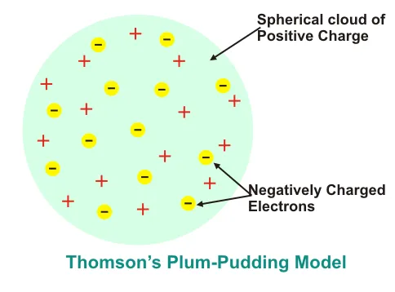
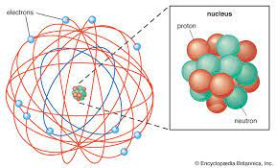
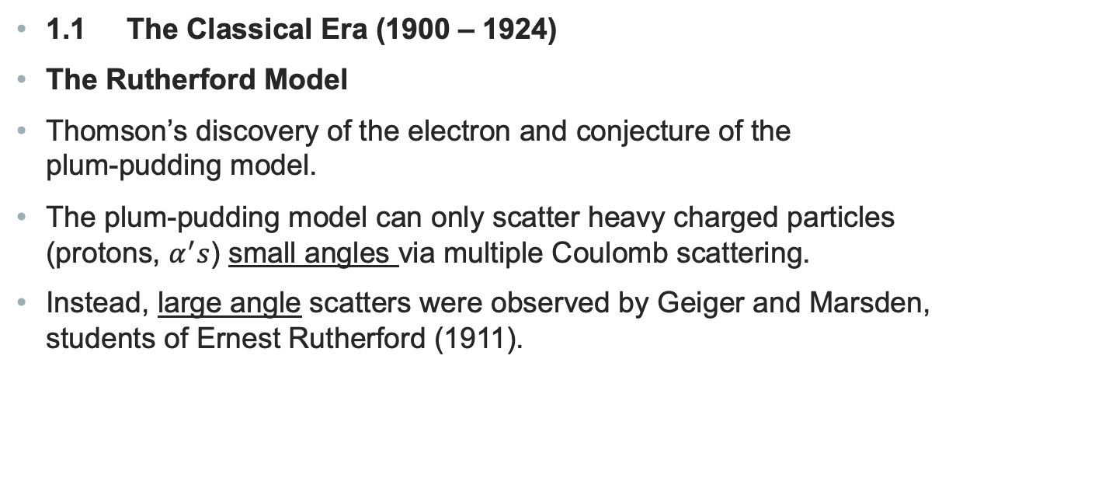
Introduction to the Elementary Particles
1.1 The Classical Era (1900 – 1924)
The Rutherford Model
Thomson’s discovery of the electron and conjecture of the
plum-pudding model.
The plum-pudding model can only scatter heavy charged particles
(protons, $α^{′}s$) small angles via multiple Coulomb scattering.
Instead, large angle scatters were observed by Geiger and Marsden,
students of Ernest Rutherford (1911).

Slide 3
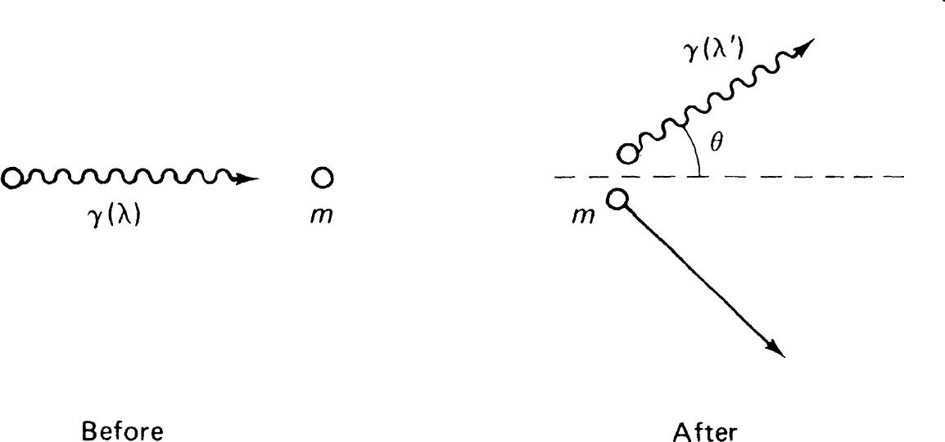
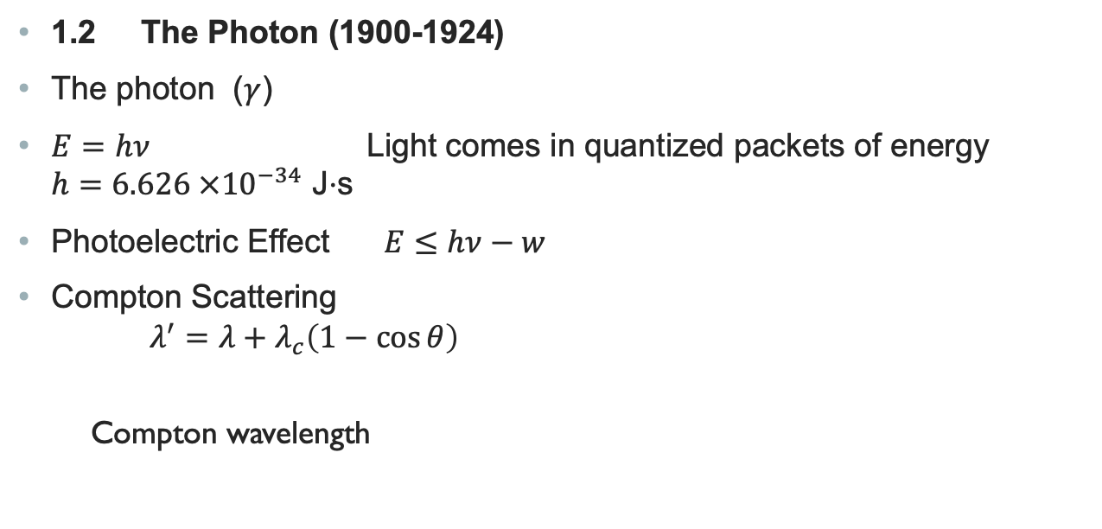

Introduction to Elementary Particles
1.2 The Photon (1900-1924)
The photon ($γ$)
$E=hν$ Light comes in quantized packets of energy
$h=6.626 ×{10}^{−34}$ J$⋅$s
Photoelectric Effect $E≤hν−w$
Compton Scattering
$λ^{′}=λ+λ_{c}\left(1−\cos{θ}\right)$
Compton wavelength
Compton Scattering
$$λ_{c}=h/mc$$

Slide 4
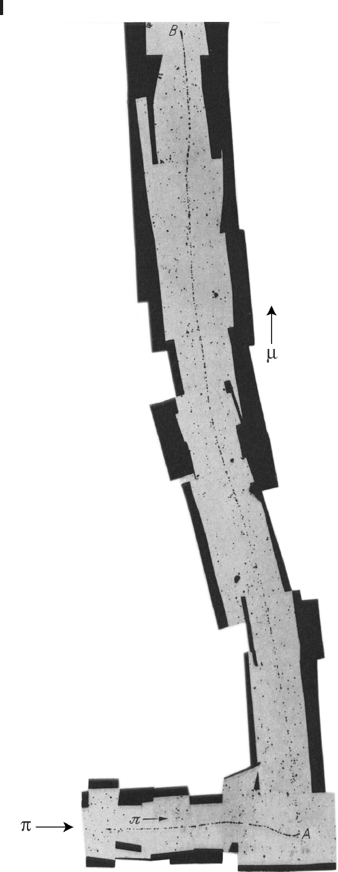
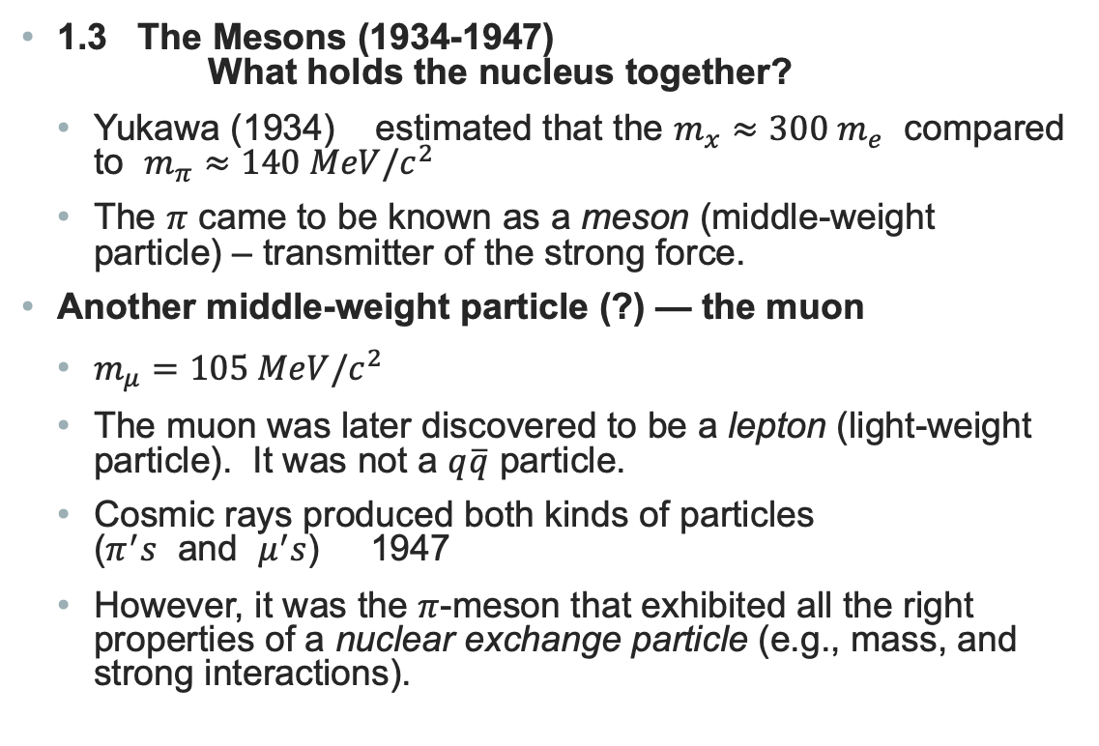
Introduction to the Elementary Particles
1.3 The Mesons (1934-1947)
What holds the nucleus together?
  Yukawa (1934) estimated that the $m_{x}≈300 m_{e}$ compared to $m_{π}≈140 MeV/c^{2}$
  The $π$ came to be known as a meson (middle-weight particle) – transmitter of the strong force.
Another middle-weight particle (?) — the muon
  $m_{μ}=105 MeV/c^{2}$
  The muon was later discovered to be a lepton (light-weight particle). It was not a $q\overline{q}$ particle.
  Cosmic rays produced both kinds of particles
  ($π^{′}s$ and $μ^{′}s$) 1947
  However, it was the $π$-meson that exhibited all the right properties of a nuclear exchange particle (e.g., mass, and strong interactions).

Slide 5
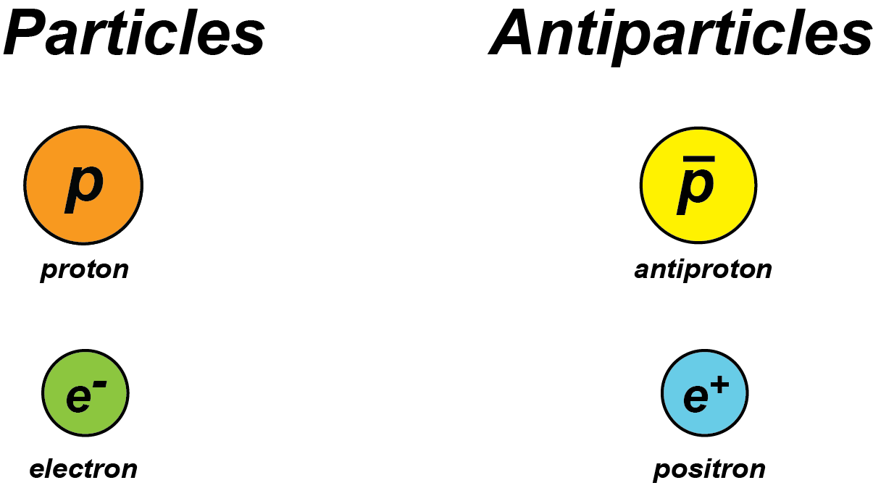
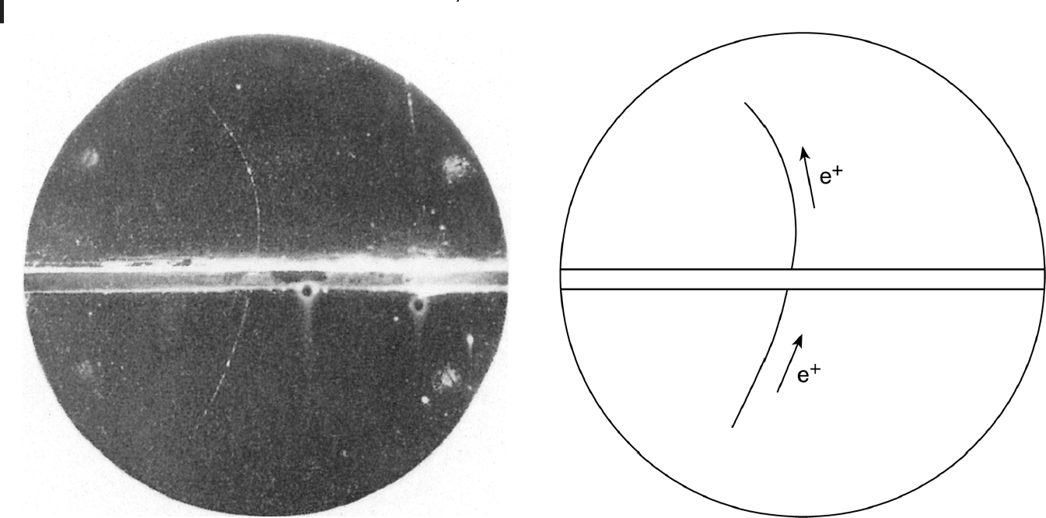
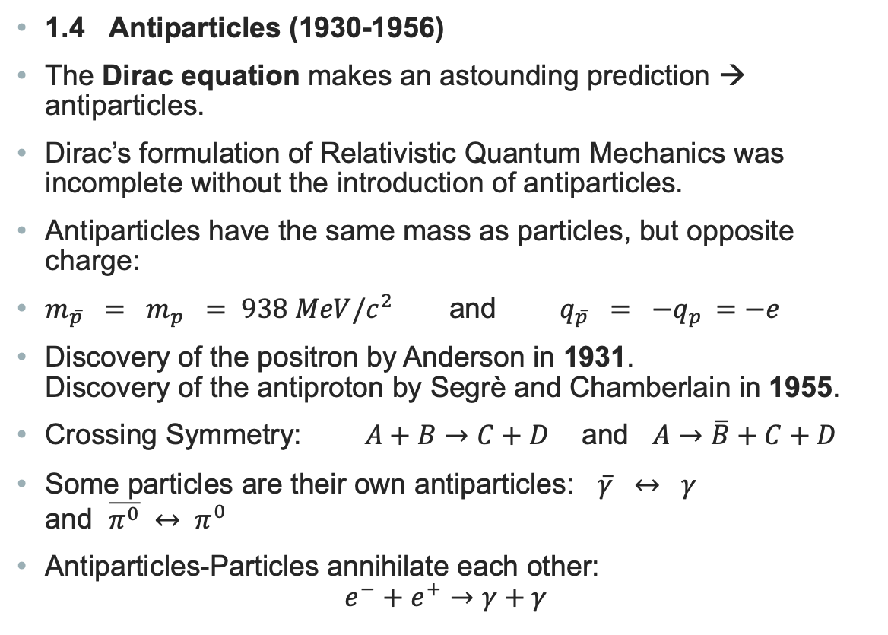
Introduction to Elementary Particles
1.4 Antiparticles (1930-1956)
The Dirac equation makes an astounding prediction → antiparticles.
Dirac’s formulation of Relativistic Quantum Mechanics was incomplete without the introduction of antiparticles.
Antiparticles have the same mass as particles, but opposite charge:
$m_{\overline{p}} = m_{p} = 938 MeV/c^{2}$ and $q_{\overline{p}} = {−q}_{p} =−e$
Discovery of the positron by Anderson in 1931.
Discovery of the antiproton by Segrè and Chamberlain in 1955.
Crossing Symmetry: $A+B→C+D$ and $A→\overline{B}+C+D$
Some particles are their own antiparticles: $\overline{γ} ↔ γ$
and $\overline{π^{0}} ↔ π^{0}$
Antiparticles-Particles annihilate each other:
$e^{−}+e^{+}→γ+γ$
Discovery of the positron in a cloud chamber

Slide 6
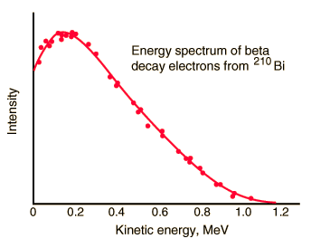
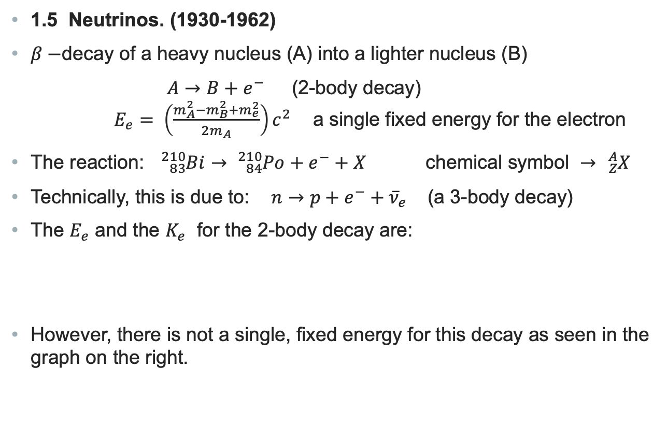
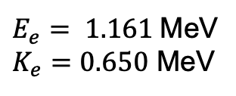
Introduction to Elementary Particles
1.5 Neutrinos. (1930-1962)
$β−$decay of a heavy nucleus (A) into a lighter nucleus (B)
$A→B+e^{−}$ (2-body decay)
$E_{e}= \left(\frac{m_{A}^{2}−m_{B}^{2}+m_{e}^{2}}{2m_{A}}\right)c^{2}$ a single fixed energy for the electron
The reaction: ${}_{83}^{210}{Bi→ {}_{84}^{210}{Po+e^{−}+X}}$ chemical symbol $→$ ${}_{Z}^{A}X$
Technically, this is due to: $n→p+e^{−}+{\overline{ν}}_{e}$ (a 3-body decay)
The $E_{e}$ and the $K_{e}$ for the 2-body decay are:
However, there is not a single, fixed energy for this decay as seen in the graph on the right.
$E_{e}= 1.161$MeV
$K_{e}=0.650$ MeV

Slide 7
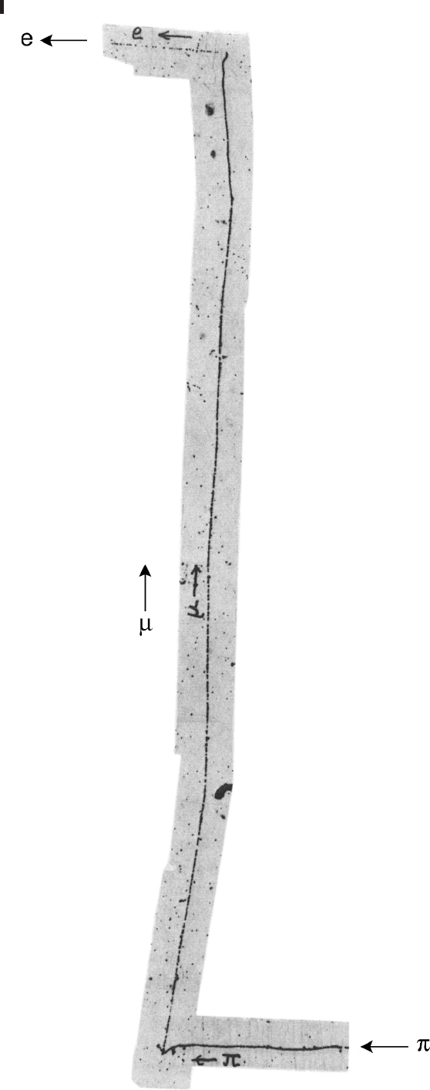
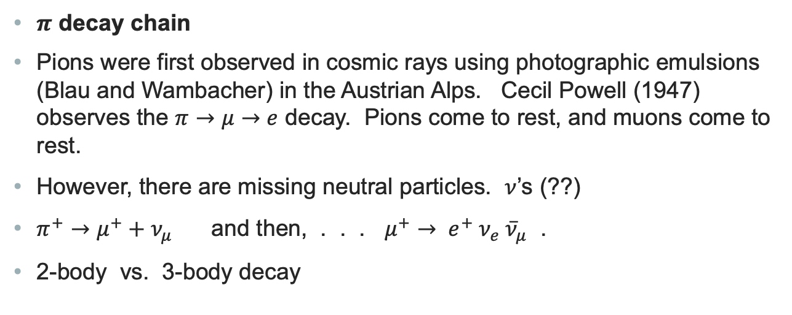
Introduction to Elementary Particles
$π$ decay chain
Pions were first observed in cosmic rays using photographic emulsions (Blau and Wambacher) in the Austrian Alps. Cecil Powell (1947) observes the $π→μ→e$ decay. Pions come to rest, and muons come to rest.
However, there are missing neutral particles. $ν$’s (??)
$π^{+}→μ^{+}+ν_{μ}$ and then, . . . $μ^{+}→ e^{+} ν_{e} {\overline{ν}}_{μ}$ .
2-body vs. 3-body decay

Slide 8
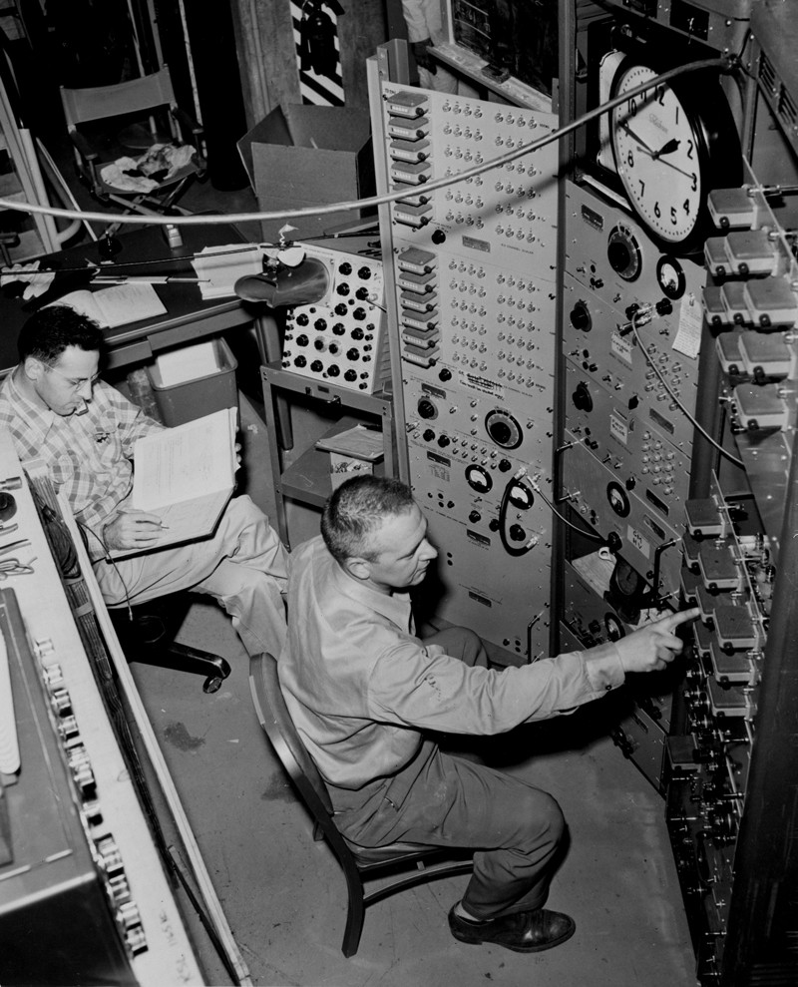
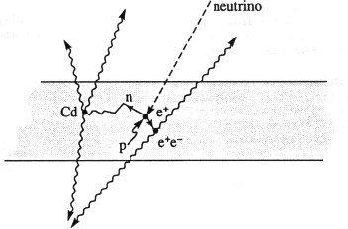

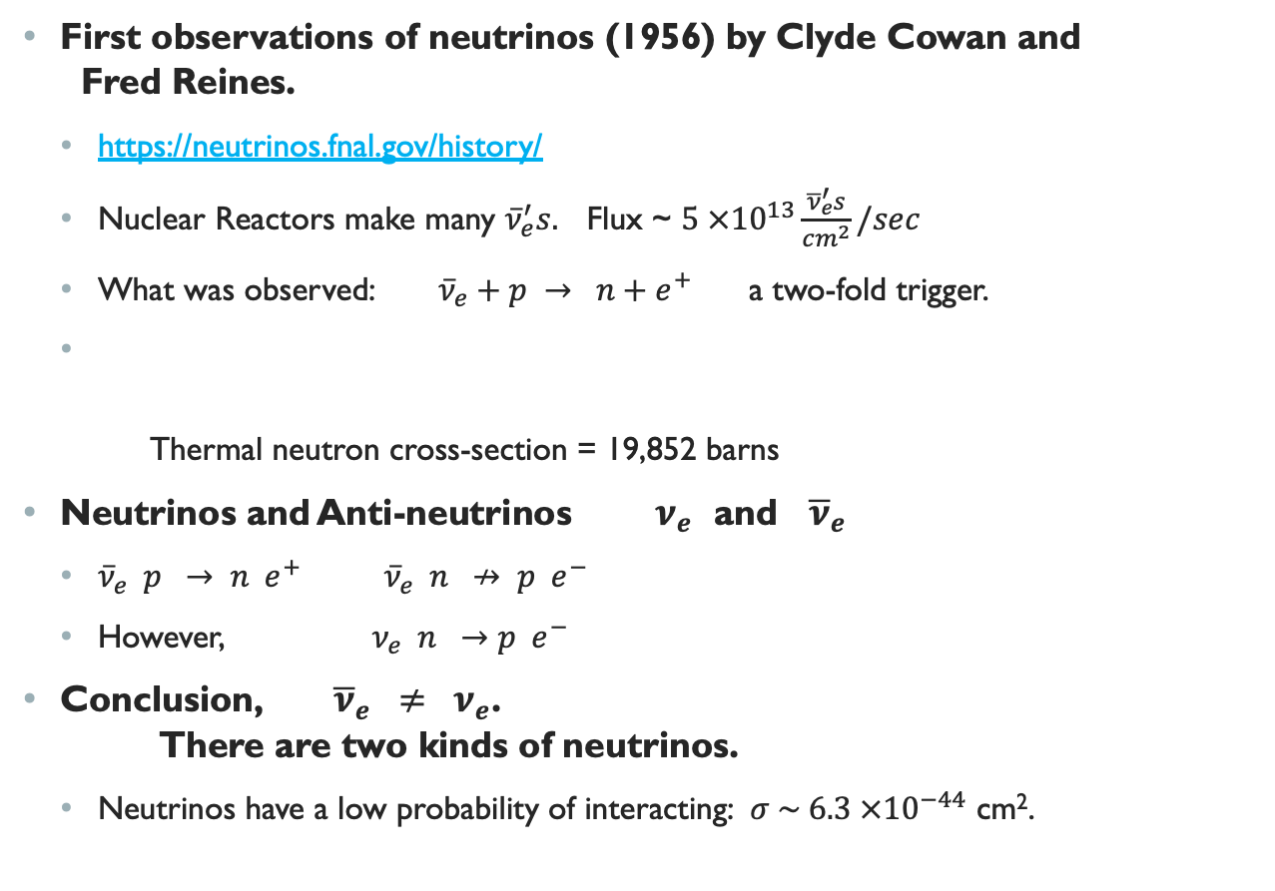


Introduction Elementary Particles
Fred Reines and Clyde Cowan
First observations of neutrinos (1956) by Clyde Cowan and
Fred Reines.
  https://neutrinos.fnal.gov/history/
  Nuclear Reactors make many ${\overline{ν}}_{e}^{′}s.$ Flux ~ $5 ×{10}^{13}\frac{{\overline{ν}}_{e}^{′}s}{cm^{2}}/sec$
  What was observed: ${\overline{ν}}_{e}+p → n+e^{+}$ a two-fold trigger.
  Thermal neutron cross-section = 19,852 barns
Neutrinos and Anti-neutrinos $ν_{e}$ and ${\overline{ν}}_{e}$
  ${\overline{ν}}_{e} p → n e^{+}$ ${\overline{ν}}_{e} n ↛ p e^{−}$
  However, $ν_{e} n →p e^{−}$
Conclusion, ${\overline{ν}}_{e} ≠ ν_{e}$.
There are two kinds of neutrinos.
  Neutrinos have a low probability of interacting: $σ \sim 6.3 ×{10}^{−44}$ cm².
$$n+ {}_{113}^{108}{Cd→{}_{113}^{109m}{Cd→ {}_{113}^{109}{Cd }+γ}}$$
$$e^{+} e^{−} → γ γ$$
$$CdCl_{2}$$
+ water

Slide 9
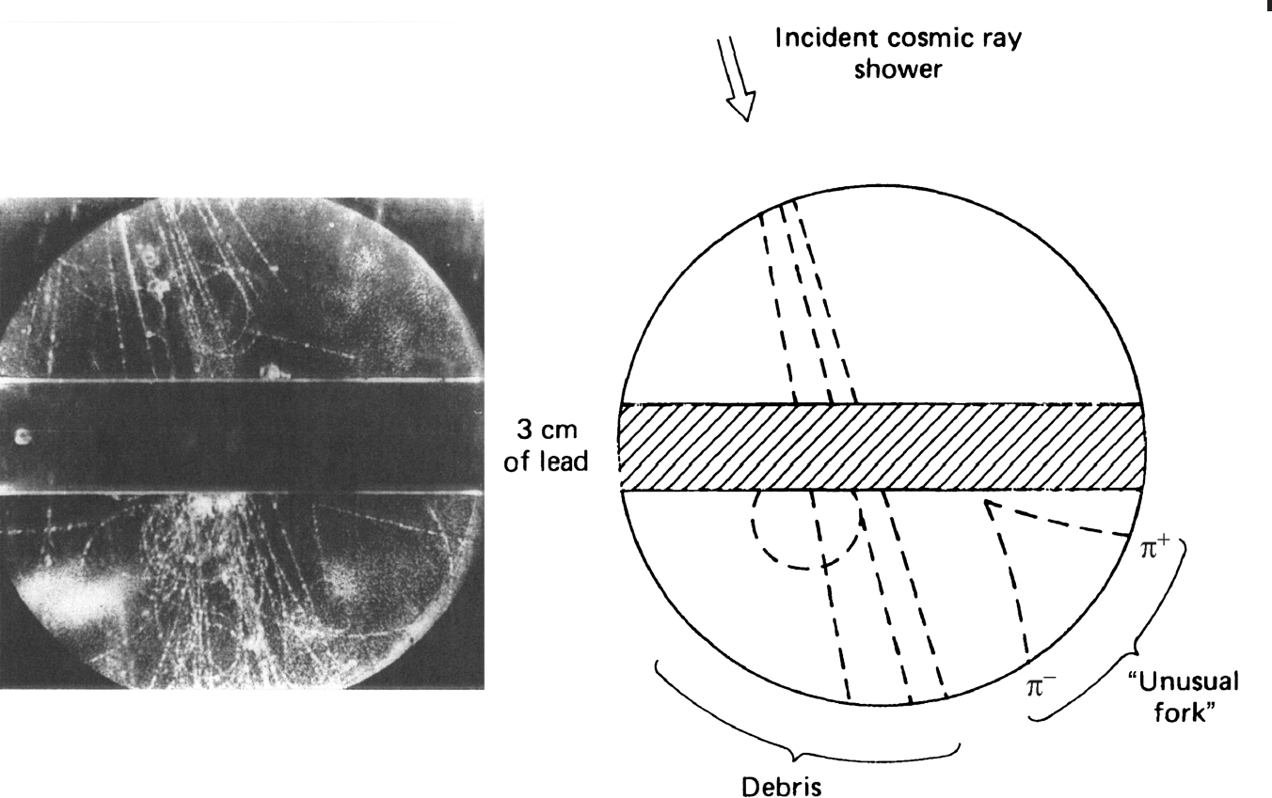
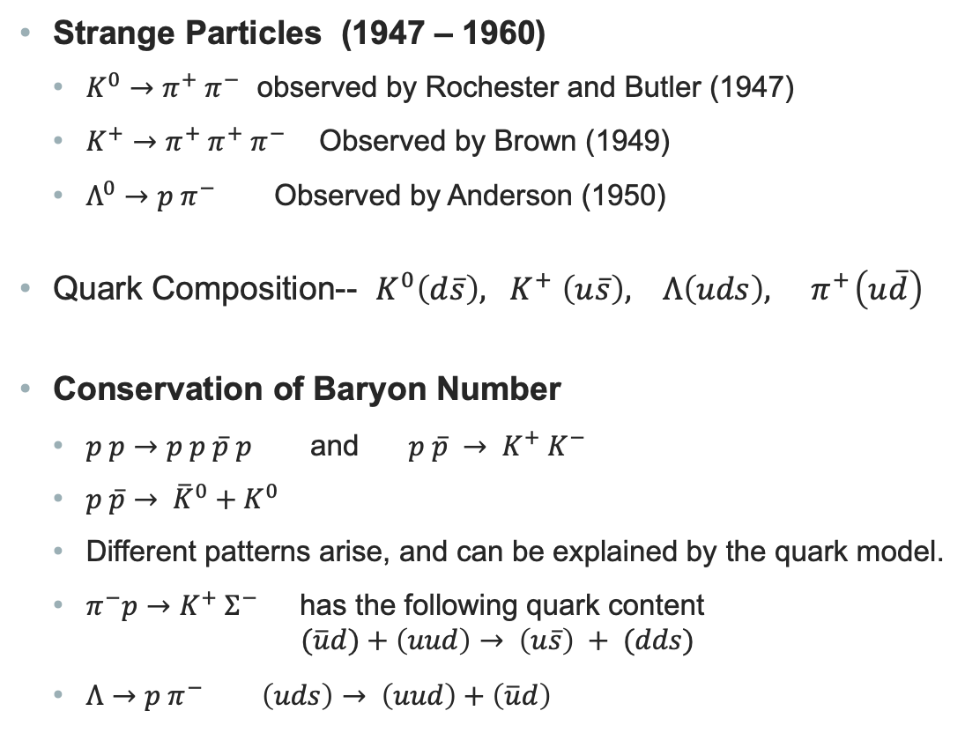
Introduction to Elementary Particles
Strange Particles (1947 – 1960)
  $K^{0}→π^{+} π^{−}$ observed by Rochester and Butler (1947)
  $K^{+}→π^{+} π^{+} π^{−}$ Observed by Brown (1949)
  $Λ^{0}→p π^{−}$ Observed by Anderson (1950)
Quark Composition-- $K^{0}\left(d\overline{s}\right), { K}^{+}\left(u\overline{s}\right), Λ\left(uds\right), { π}^{+}\left(u\overline{d}\right)$
Conservation of Baryon Number
  $p p→p p \overline{p} p$ and $p \overline{p} → K^{+} K^{−}$
  $p \overline{p}→ {\overline{K}}^{0}+K^{0}$
  Different patterns arise, and can be explained by the quark model.
  $π^{−}p→K^{+} Σ^{−}$ has the following quark content
  $(\overline{u}d)+\left(uud\right)→ \left(u\overline{s}\right) + (dds)$
  $Λ→p π^{−} \left(uds\right)→ \left(uud\right)+\left(\overline{u}d\right)$
The Particle “Zoo”
Where does it end?
How do we classify these particles?

Slide 10
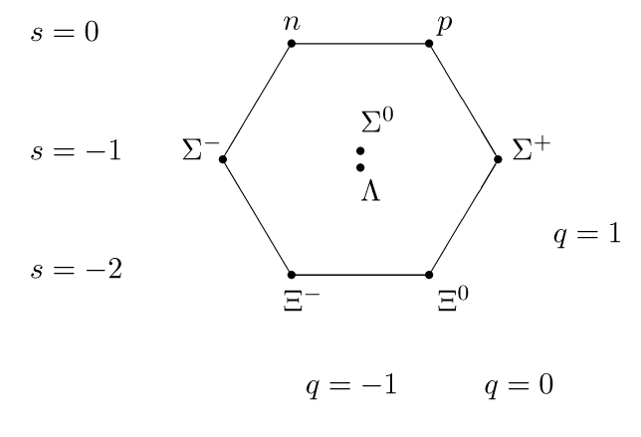
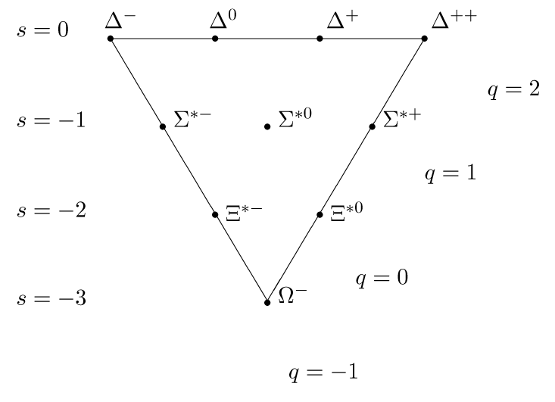
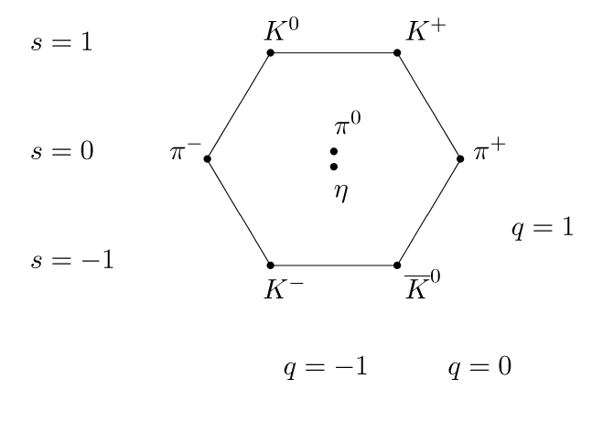
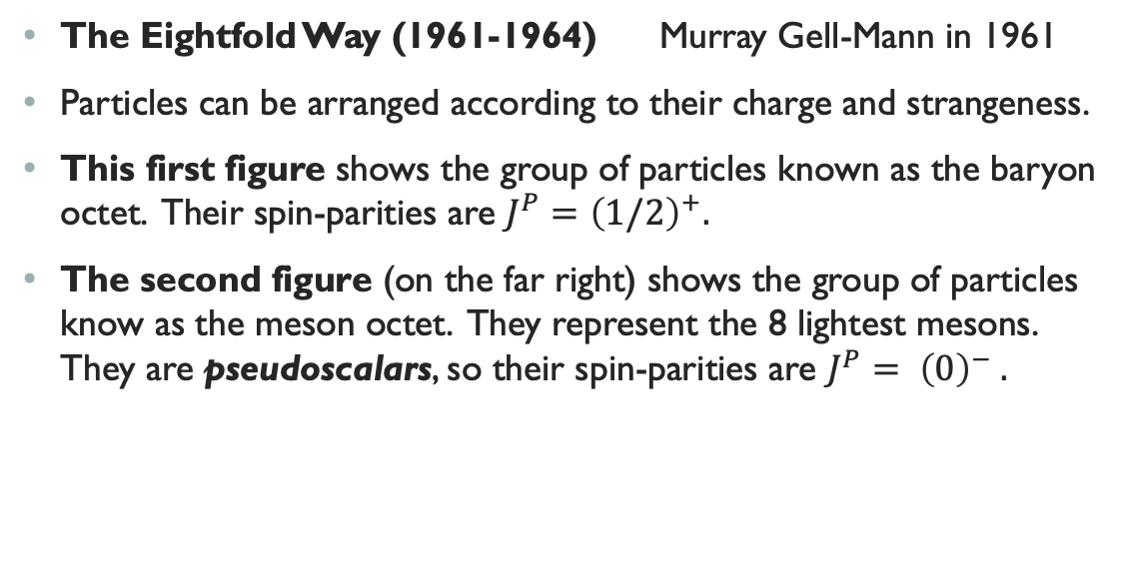

Introduction to Elementary Particles
The Eightfold Way (1961-1964) Murray Gell-Mann in 1961
Particles can be arranged according to their charge and strangeness.
This first figure shows the group of particles known as the baryon octet. Their spin-parities are $J^{P}={\left(1/2\right)}^{+}.$
The second figure (on the far right) shows the group of particles know as the meson octet. They represent the 8 lightest mesons. They are pseudoscalars, so their spin-parities are $J^{P}= {\left(0\right)}^{−} .$
The third figure
Baryon Decuplet has $J^{P}= {\left(\frac{3}{2}\right)}^{+}$

Slide 11
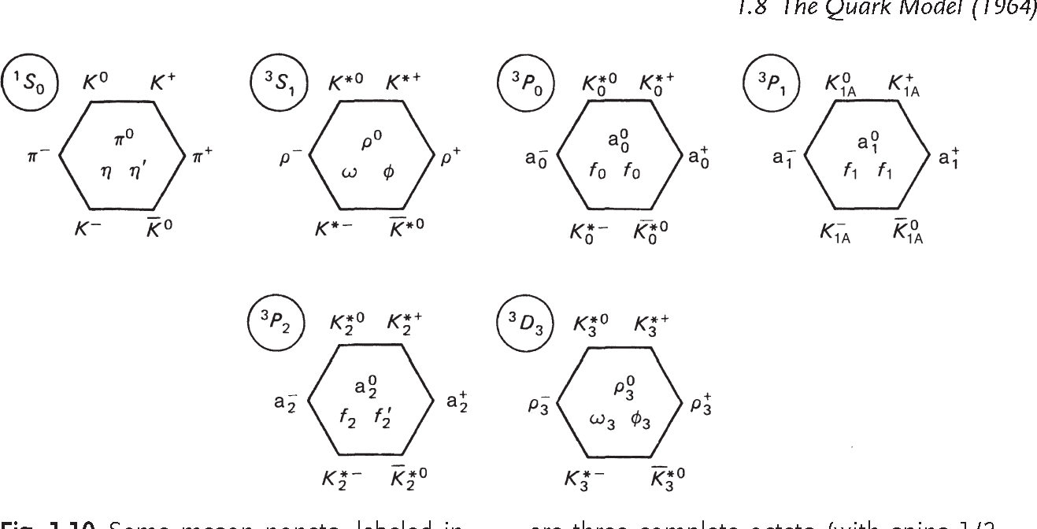
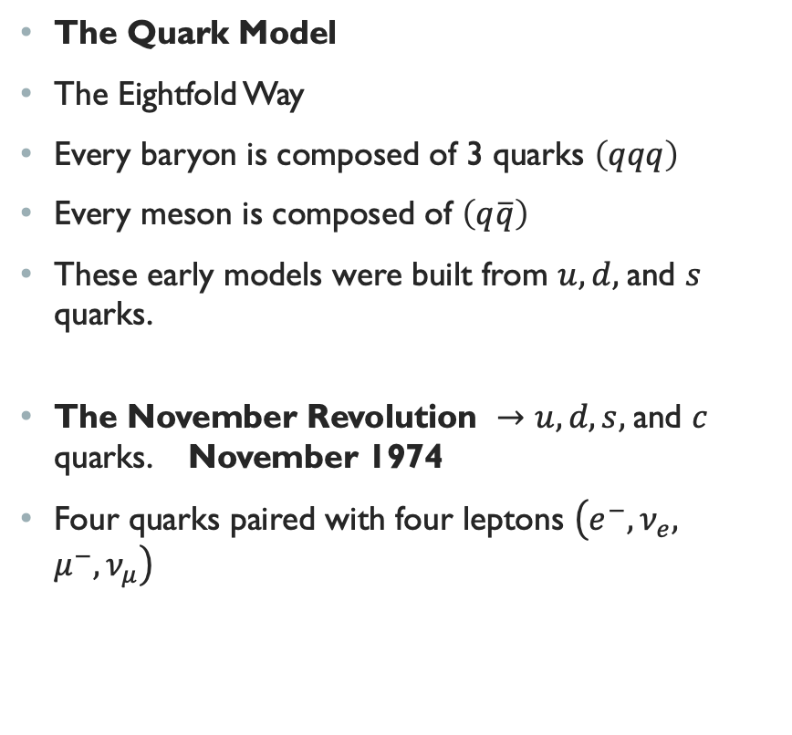
$Introduction to$Elementary Particles
The Quark Model
The Eightfold Way
Every baryon is composed of 3 quarks $\left(qqq\right)$
Every meson is composed of $\left(q\overline{q}\right)$
These early models were built from $u, d,$and $s$ quarks.
The November Revolution $→u, d, s,$and $c$ quarks. November 1974
Four quarks paired with four leptons $\left(e^{−}, ν_{e}, μ^{−}, ν_{μ}\right)$

Slide 12
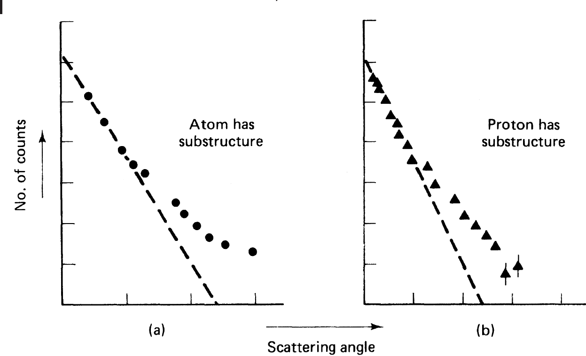
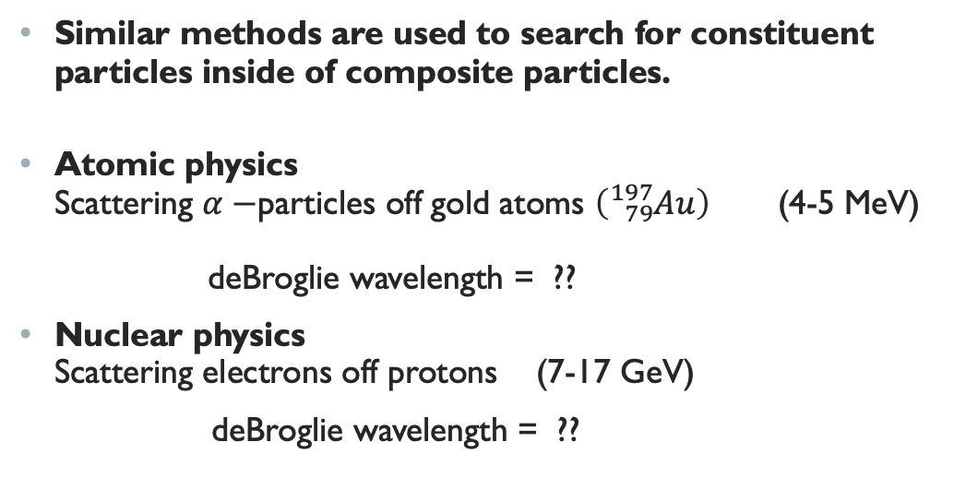
Introduction to Elementary Particles
Similar methods are used to search for constituent particles inside of composite particles.
Atomic physics
Scattering $α−$particles off gold atoms $\left({}_{79}^{197}{Au}\right)$ (4-5 MeV)
deBroglie wavelength = ??
Nuclear physics
Scattering electrons off protons (7-17 GeV)
deBroglie wavelength = ??
observed
observed
If no substructure is present

Slide 13
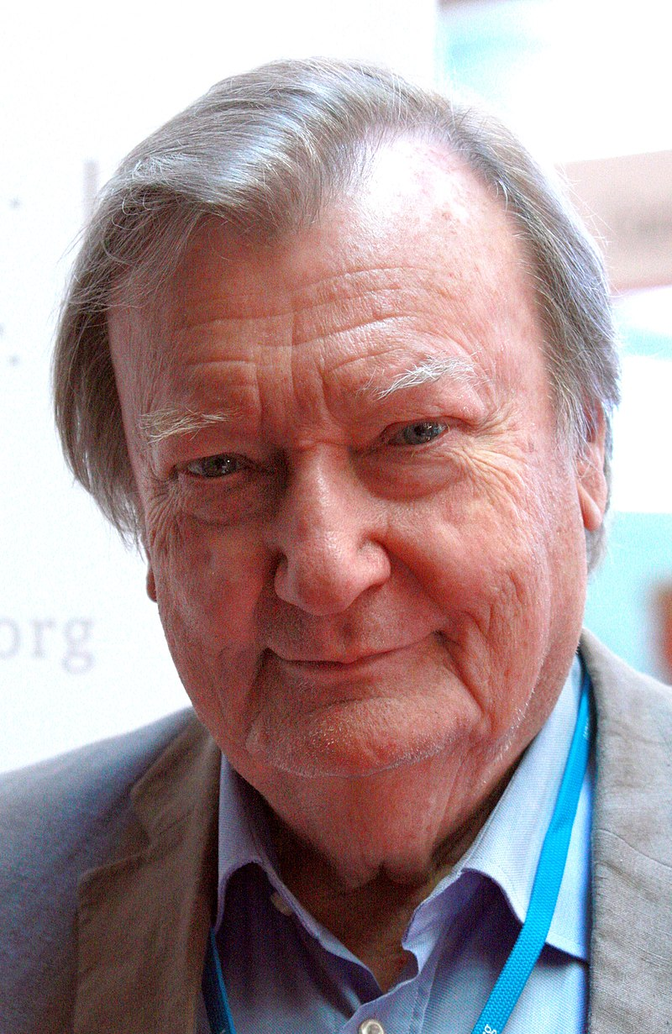
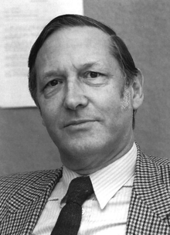
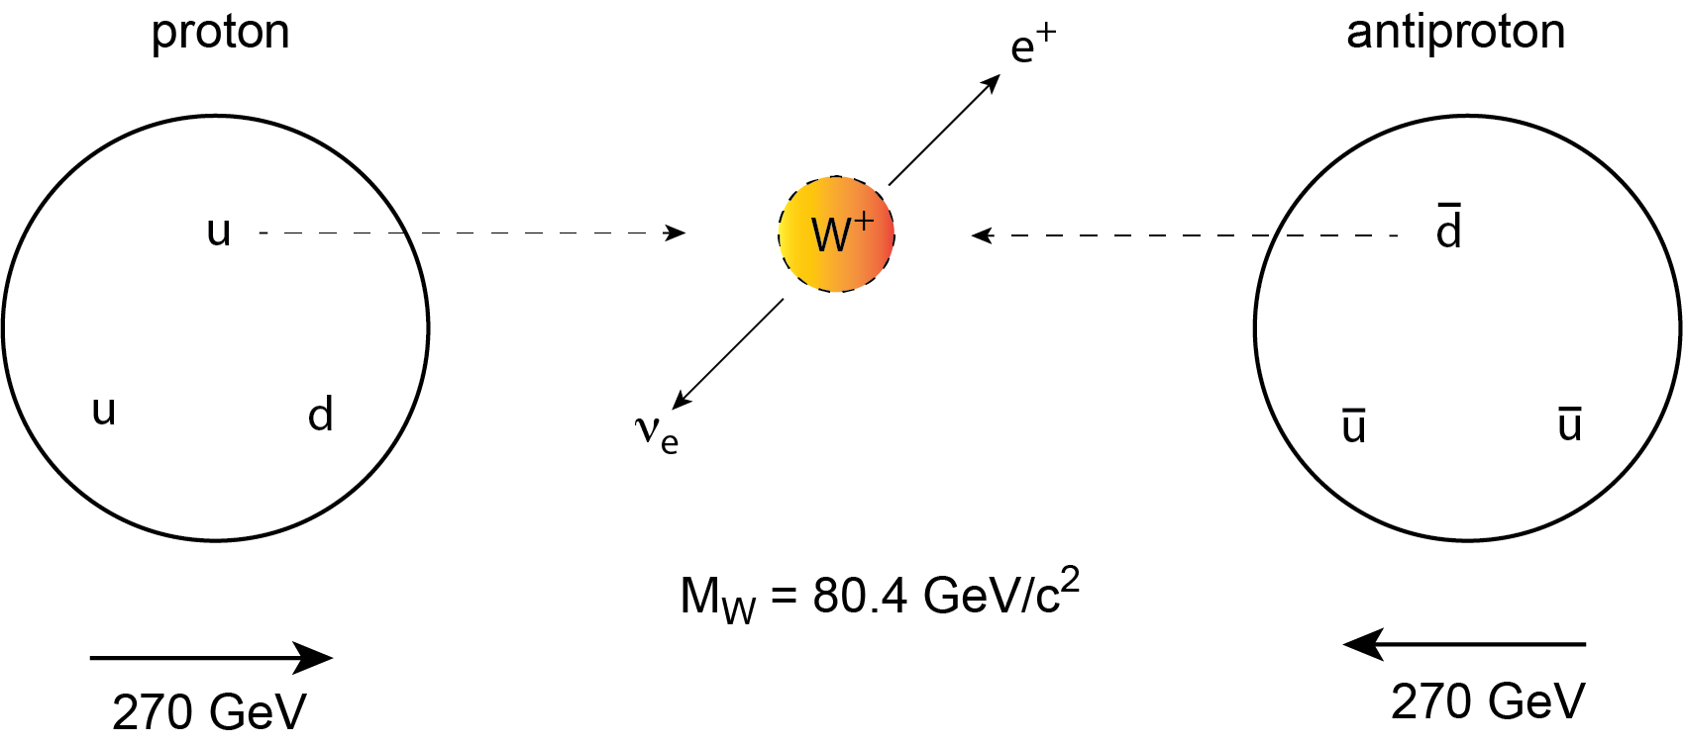
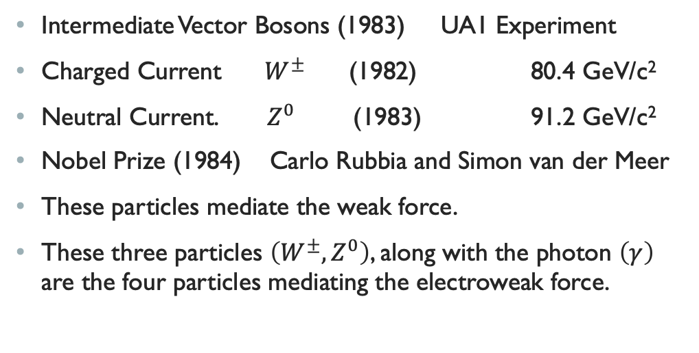
Introduction Elementary Particles
Intermediate Vector Bosons (1983) UA1 Experiment
Charged Current $W^{±}$ (1982) 80.4 GeV/c²
Neutral Current. $Z^{0}$ (1983) 91.2 GeV/c²
Nobel Prize (1984) Carlo Rubbia and Simon van der Meer
These particles mediate the weak force.
These three particles $\left(W^{±},Z^{0}\right)$, along with the photon $\left(γ\right)$ are the four particles mediating the electroweak force.
Carlo Rubbia
Simon van der Meer

